Slide 1







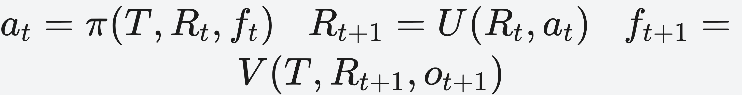

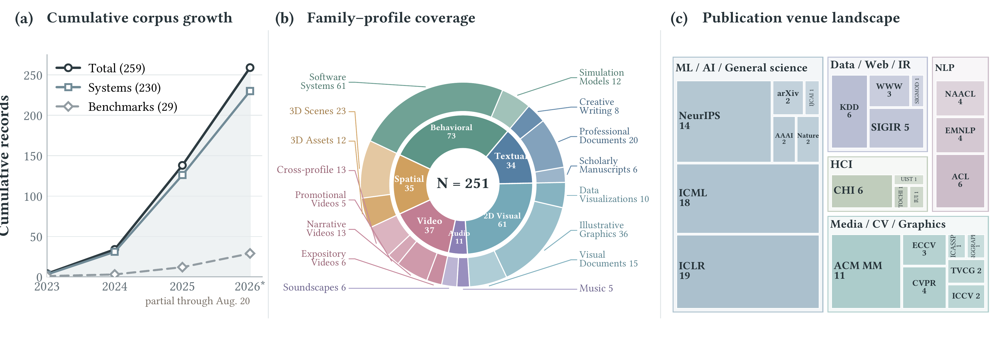
Agentic Artifact Creation: Systems, Evaluation, Principles, and Opportunities
Tianfu Wang, Zhezheng Hao, Xilin Xia, Lixin Liu, Mengkang Hu, Hongzhang Liu, Xi Chen, Ziyan Liu, Xiankun Lin, Weijia Zhang, Nicholas Jing Yuan, Hui Xiong
HKUST (Guangzhou) · Zhejiang University · USTC · Tsinghua University · HKU · University of Sydney · Sun Yat-sen University
Problem
Method
Key Results
Generative models cheaply draft content — but real impact needs
complete, dependable deliverables whose requirements interact
and whose failures resist easy repair.
Agentic creation = the system builds the artifact, carries state,
and lets observations redirect later work — a loop of three roles: an
Operational Representation, a Construction Policy, and
Runtime Verification that turns observations into feedback.
Difficulty reflects not only modality but how tightly decisions
couple and whether failures surface early enough to still be
repaired in time.
A plausible image or a single quality score cannot prove
that a poster, program, or scene is ready to deliver.
6
3
3/29
artifact families
difficulty axes
test beyond capability
Decomposition cuts local complexity but raises coordination
cost; learned judges add little evidence when they share the
generator's blind spots.
policy → update → verification repeat until delivery
Headline Numbers
Fig 1. Direct generation (a) cannot redirect later actions; agentic creation
(b) couples a Construction Policy, Operational Representation, and
Runtime Verification into a feedback loop.
259
230
agentic systems
29
benchmarks
Fig 2. The review corpus: growth to 259 works, six artifact families, and
the publication venue landscape.
works reviewed through Aug 20, 2026
6
artifact families
the first survey to define agentic artifact creation as stateful
construction
4
design principles
Motivation
When a deliverable satisfies coupled criteria, a one‑way pipeline
exposes failure only at the end — forcing failure propagation,
weak localization, and broad regeneration.
Corpus
Takeaway
259 works reviewed — 230 agentic systems and 29 benchmarks
— spanning six artifact families by primary delivered form:
SO WHAT
vs.
Agentic construction earns its complexity when observations
improve later decisions enough to justify the control cost — the
payoff is bounded revision and state preservation.
DIRECT GENERATION
AGENTIC CREATION
ARTIFACT FAMILY
SYSTEMS
Fixed schedule; observations
do not redirect work.
State + observations redirect
work — composability,
revisability.
Behavioral
73
2D Visual
61
Four principles keep control coherent: externalize commitments,
define control boundaries, make feedback actionable, and
revalidate affected state. Direct generation still wins when little
accepted state must be preserved.
Spatial / Video
35 / 37
The construction loop pays off only when observations locate
failures at a scope the available actions can actually repair.
Textual / Audio
34 / 11

