Slide 1


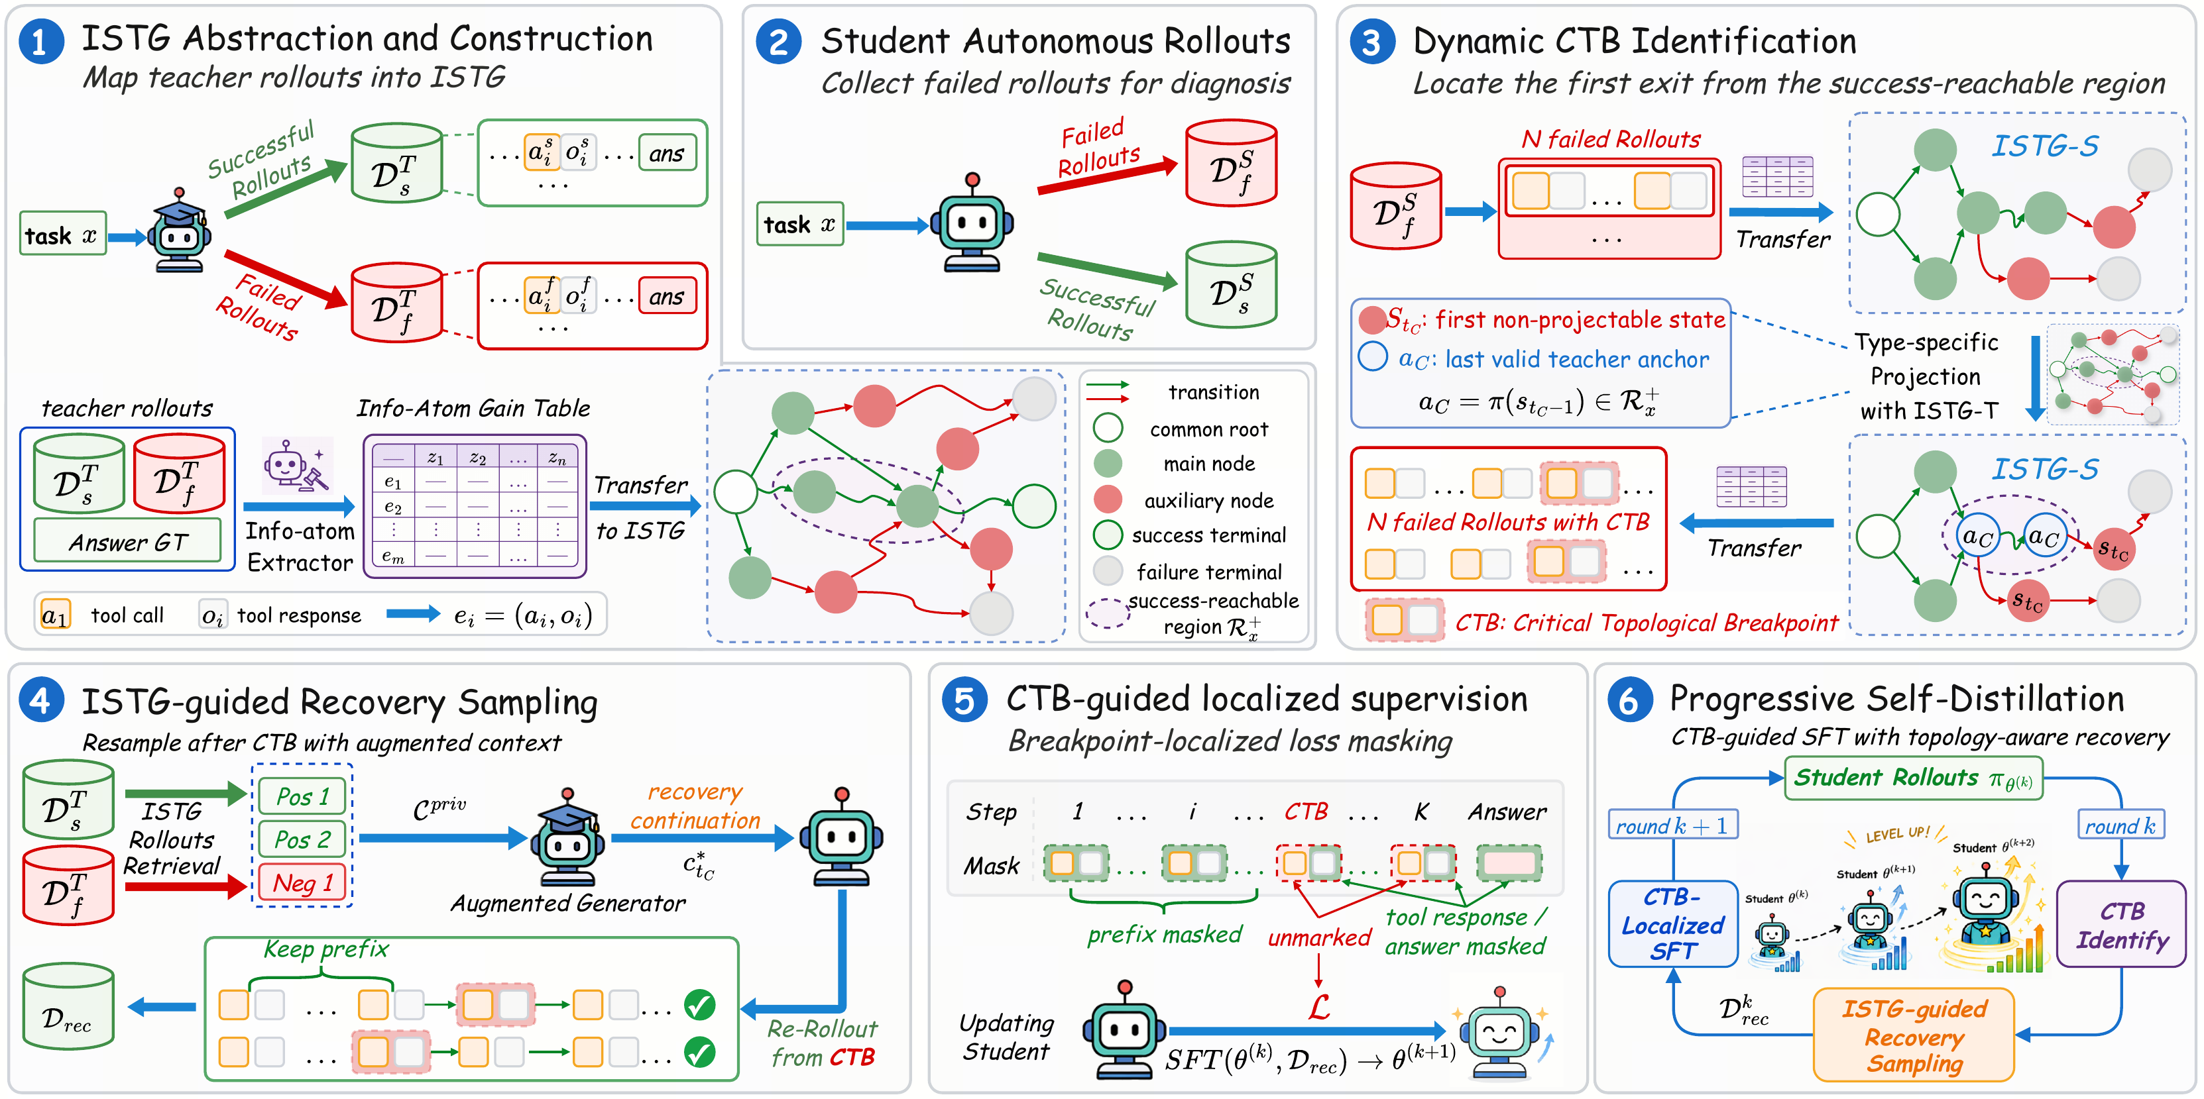
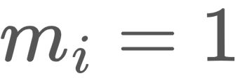
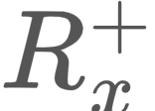

DART-SD: Diamond-topology Aware Retrieval & Tuning for Self-
Distillation of Multi-Turn Tool-Calling Agents
Hangrui Xu^{1,★}, Jiarui Wang^{1,★}, Yang Yang^{1,★}, Chuanbo Zhu¹, Fangda Chen¹, Ziqi Wu¹, Jingming Cai¹, Yan Song²
¹ByteDance ²University of Science and Technology of China ★ Equal contribution
Problem
Method
Ablation Study
Agent distillation forces multi-turn
tool-calling students to imitate full
teacher trajectories. With order-
independent sub-goals, the valid
solution space forms a combinatorial
diamond lattice no linear trajectory
can represent.
COMPONENT
SOLVE-F1
Qwen3-8B base
23.5
+ Self-Distillation
38.1
+ CTB supervision
39.5
+ Progressive SFT
43.9
+ ISTG (full DART-SD)
45.7
Forcing rich topology into
monolithic trajectories causes
topological collapse, degrading
policy diversity.
SO WHAT → Every component contributes to the final gain.
Takeaway
Motivation
Correct only where the student
first leaves the recoverable
region — protect what it got
right.
Global forcing overwrites
exploration. SFT teacher boosting
applies an indiscriminate loss that
erases valid exploratory steps.
Topology-aware localized correction yields compact tool-calling agents that are more efficient, more general, and beat their own teachers on several benchmarks — without full-trajectory imitation.
DART-SD builds an ISTG, locates each failed rollout's CTB by projection onto , then self-distills a breakpoint-localized recovery: , mask on post-CTB tokens only.
Linear credit is misaligned. RL
(GRPO) spreads reward uniformly;
hindsight treats interaction as a
strict sequence, confusing errors
with detours.
Key Results
Headline Numbers
METHOD (8B)
FTRL
TOOLHOP
AVG.
45.7
45.6
avg. over 5
benchmarks
vs.
Best baseline
41.9
44.7
41.6
PRIOR WORK
DART-SD
DART-SD (Ours)
45.7
45.0
45.6
FTRL Solve-F1 (Qwen3-
8B)
3.55
tool calls vs 4.02
golden
Scan to Read
Force full-
trajectory
imitation.
Correct only
past the
breakpoint.
SO WHAT → Best average on both backbones; 8B beats its teacher on FTRL, ToolHop and τ-bench with far fewer parameters.
Paper
arxiv.org/abs/2608.18524
nearly doubles the 23.5 base —
even surpasses the teacher
+6.0
gen-capability
avg. gain
Shorter tool traces, higher MMLU / AIME.
Paper

