Slide 1



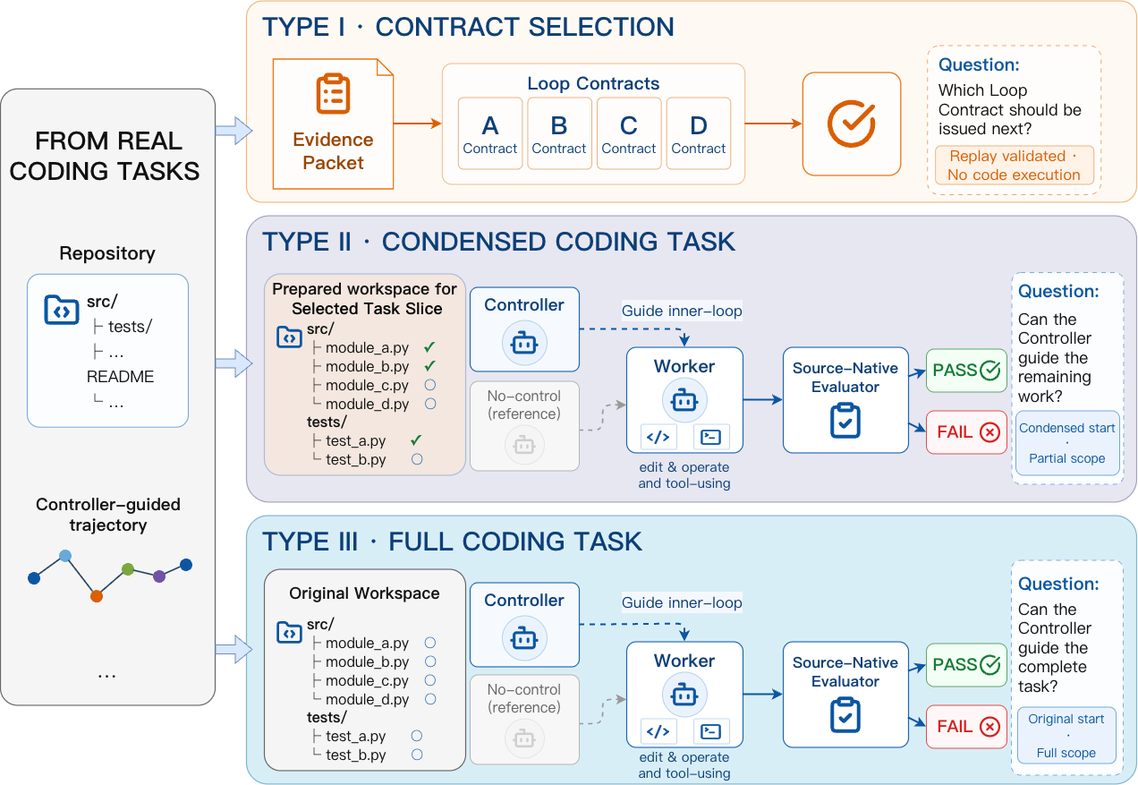
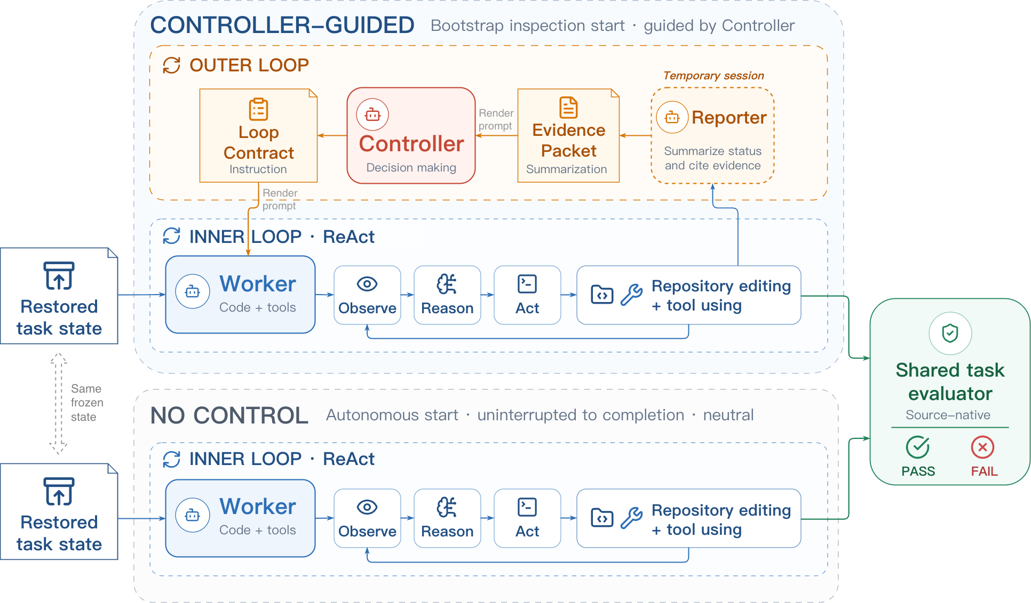
LoopArena: Benchmarking Models as Runtime Controllers for Loop Engineering
Yi Wang¹, Haopeng Zhang¹, Chengxiang Huang^{1,2}, Rui Dai¹, Kaikui Liu¹, Piotr Koniusz³, Xiangxiang Chu¹
¹DreamX Team, Alibaba Group · ²Beijing Univ. of Posts & Telecommunications · ³UNSW Sydney; Data61, CSIRO
Problem
Method
Dataset / Benchmark
Loop Engineering runs coding agents inside loops that decide
each step. But one run’s outcome cannot separate the loop’s
guidance from the agent.
1
Worker runs an Observe–Reason–Act round (code + tools).
90 Type I questions + 27 paired Type II–III instances, from long-
horizon coding suites:
2
Reporter distills progress into a read-only Evidence Packet.
A loop may trust a stale note or stop early — unmeasurable.
3
Controller (under test) reads the Packet, issues a Loop
Contract.
SlopCodeBench
BeyondSWE
Motivation
4
Contract sets the next segment or stops; a shared evaluator
scores it.
The real skill in loop engineering is deciding, after each round,
what the agent should do next — a decision existing coding
benchmarks never isolate or test.
PRIOR BENCHMARKS
vs.
LOOPARENA
Score the whole agent or
isolated sub-skills.
Makes the control decision
the object of evaluation.
Controller policy π maps history + Evidence Packet → next Loop Contract
Key Results
CONTROLLER · TYPE III FULL TASK
STRICT SR
Claude Opus 4.8
20.99
GPT-5.5 (best)
24.69
Type II slices reproduce the full-task ranking, 64.4%
cheaper.
Constructing the three settings: Type III uses the full task, Type II a
prepared slice, and Type I replays four candidate Loop Contracts offline.
Takeaway
Headline Numbers
Fix the Worker, vary the Controller: LoopArena makes
runtime loop control a directly measurable skill — and
even today’s best models steer only about one in four long
coding runs to success, while a cheap task-slice proxy
faithfully preserves their full-task ranking.
24.69%
0.9747
Type II–III rank ρ
The LoopArena harness. Both conditions start from the same restored
state; the Controller-guided outer loop adds a Reporter, Evidence Packet,
and Loop Contract around the fixed Worker inner loop.
best full-task Strict Success Rate (GPT-5.5)
64.4%
avg inference-cost cut
only ~1 in 4 long coding runs steered to success
90+27
Type I Qs + task pairs
════════════════════════════════════════════════════════════════════════ -->

