Slide 1


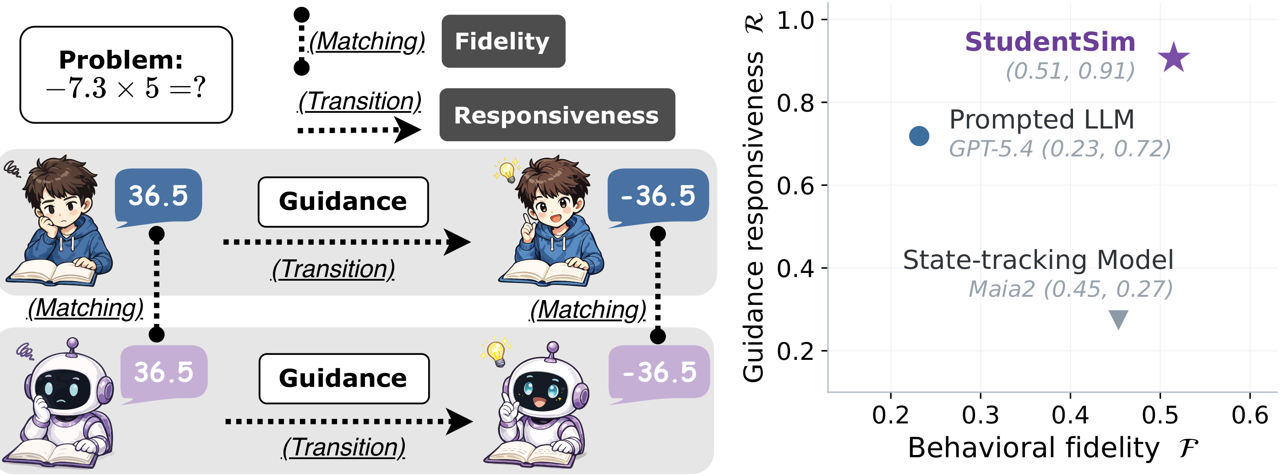
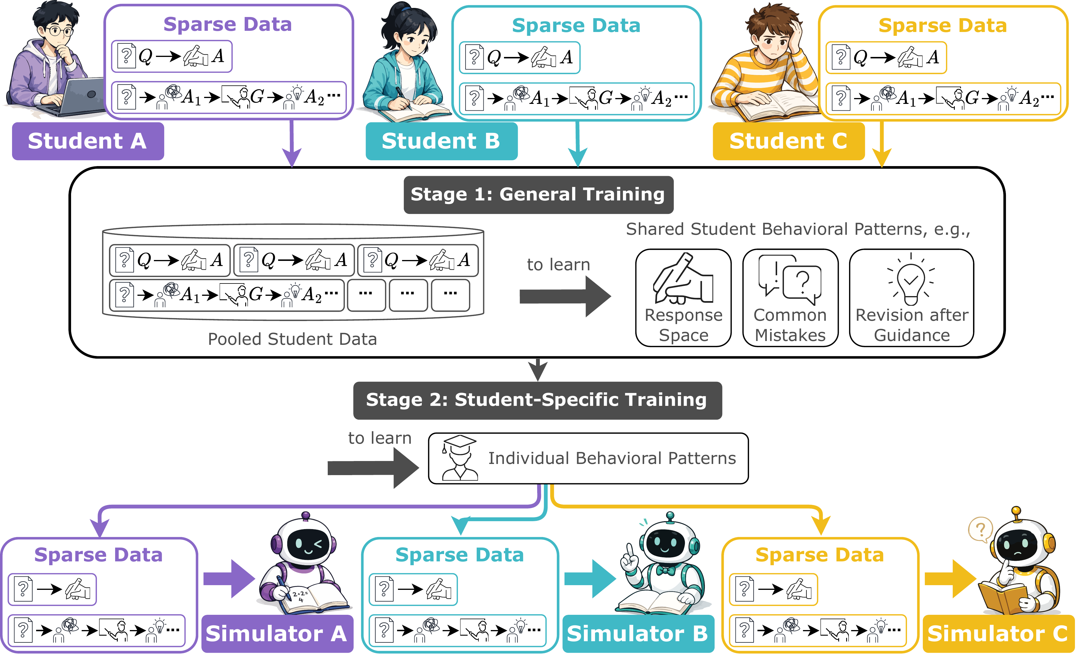
StudentSim: Training LLM-based Student Simulators
Ke Yang^{1,2}*, Chenglong Wang¹, Michel Galley¹, Chandan Singh¹, Jeevana Priya Inala¹, ChengXiang Zhai², Jianfeng Gao¹
¹Microsoft Research ²University of Illinois Urbana-Champaign *Work done during an internship at Microsoft Research
Problem
Method
Key Results
AI tutors get useful only with per-student feedback on which guidance works — but that signal is sparse, slow, and costly to collect from real learners.
1
Stage 1 — Pooled training. Pool the sparse records of all students in a domain to pretrain one base simulator that captures shared mistakes and how students revise after guidance.
StudentSim reaches ℱ=0.51 / ℛ=0.91 on chess, beating both baselines on both axes.
Recruiting a diverse student population to train tutors is prohibitively expensive, so tutor progress lags the models.
2
Stage 2 — Per-student specialization. Initialize from the base and adapt it on a single student's own records → one individualized simulator per student.
Motivation
3
Deploy as reward. A frozen StudentSim then serves as the reward source for tutor reinforcement learning, closing the loop from simulation to tutor improvement.
State-tracking models (knowledge tracing, Maia2) capture how a student behaves, but can't digest a tutor's explanations or corrections.
Where each method lands on chess: StudentSim leads on both axes; each baseline wins only one.
Prompted LLMs follow guidance fluently, yet don't reliably reproduce the competence of the student they imitate.
Each per-student simulator M_{i} jointly maximizes behavioral fidelity ℱ and guidance responsiveness ℛ.
Headline Numbers
PRIOR SIMULATORS
vs.
STUDENTSIM
0.91
0.51
Win only one axis — fidelity or responsiveness, never both.
Jointly faithful and guidance-responsive per student.
Behavioral fidelity ℱ (chess)
Guidance responsiveness ℛ (chess)
60
students · 3 domains
vs 0.72 GPT-5.4 · 0.27 Maia2
1st
expert-rated tutor (RL reward)
Takeaway
Dataset / Benchmark
Individualized simulators that are jointly faithful and guidance-responsive turn student simulation into an optimizable objective for real AI-tutor improvement.
StudentSimEval: 60 students across chess, L2 English writing, and math, from public learner corpora with shared records.
Fixed per-student schema with frozen train / held-out splits — every method scored on identical data.
PROOF OF CONCEPT
A StudentSim-reward tutor is rated by experts as more
accurate and better-guided than no-RL and GPT-5.4-reward
baselines.
Chess
L2 English writing
Mathematics
60 students
A StudentSim-reward tutor is rated by experts as more accurate and better-guided than no-RL and GPT-5.4-reward baselines.
public corpora
released code
Two-stage training: Stage 1 pools many students to pretrain a base; Stage 2 specializes it per student.

